Slide 1

Degree-based Balanced Clustering for Large-Scale Software Defined Networks Talha Ibn Aziz*, Shadman Protik*, Md Sakhawat Hossen*, Salimur Choudhury†, Muhammad Mahbub Alam* IEEE Wireless Communication and Networking Conference (WCNC) 15-19 April 2019, Marrakech, Morocco. * Department of Computer Science and Engineering, Islamic University of Technology, Board Bazar, Gazipur, Bangladesh. † Department of Computer Science, Lakehead University, Thunder Bay, Ontario, Canada.

Slide 2

Topics To Be Covered
Software Defined Networks (SDNs)
Controller Placement Problem (CPP)
Motivation
Contribution
Degree-based Balanced Clustering
Experimental Analysis
Conclusion and Future Work
Degree-based Balanced Clustering for Large-Scale Software Defined Networks

Slide 3
Software Defined Networks (SDNs)
Software Defined Networks (SDN) decouples the network layer of the traditional protocol stack into the control plane and the data plane.
The control plane controls the path selection mechanism and the data plane follows the mechanism to forward data packets.
Devices with high processing capacity called ‘controllers’ communicate with the data plane devices (switches) as per requirement.
The initial design of SDNs include a single controller in a network.
Degree-based Balanced Clustering for Large-Scale Software Defined Networks

Slide 4
Controller Placement Problem (CPP)
The single controller design gave rise to issues like scalability, reliability – a single point of failure, security, and the formation of a bottle-neck due to overflow of switch-controller queries.
Researches propose a multiple controller approach which introduced a few questions:
How many controllers?
Where to place them?
Which switch falls under which controllers?
Several parameters need to be optimized to place multiple controllers, making the solution to the Controller Placement Problem (CPP) NP-Hard.
4
Degree-based Balanced Clustering for Large-Scale Software Defined Networks

Slide 5
Motivation
To the best of out knowledge,
No optimal solution to the CPP has yet been proposed.
The researches done are either exhaustive or work with optimizing a single parameter (latency, reliability, etc.).
Our proposed algorithm Degree-based Balanced Clustering places controllers in polynomial time complexity. DBC simultaneously deals with multiple parameters.
DBC outperforms state-of-the-art controller placement algorithms like Density Based Controller Placement (DBCP), in terms of Flow-Setup Latencies and Load Balancing.
5
Degree-based Balanced Clustering for Large-Scale Software Defined Networks

Slide 6
Contribution
DBC is a novel and efficient controller placement algorithm which optimizes the following parameters:
Flow setup latency – The maximum latency incurred to set the path for a new data packet.
Route synchronization latency – Synchronization delay in case of a change in the network due to a link or switch failure.
Load of a controller – The balancing of loads handled by the controllers. The switches are assumed to have identical load.
In order to achieve the mentioned goals, DBC forms balanced clusters in terms of both cluster size and inter-switch distances.
6
Degree-based Balanced Clustering for Large-Scale Software Defined Networks

Slide 7
Degree-based Balanced Clustering
Our proposed algorithm performs Controller Placement in three phases.
Cluster Formation – Group switches for placing a controller (in each group).
Controller Selection - Select one controller among the switches in a group based on some parameters.
Selection of optimum number of controllers - Change the number of controllers and repeat the process to find the optimal configuration.
7
Degree-based Balanced Clustering for Large-Scale Software Defined Networks

Slide 8
Cluster Formation
Find an approximate cluster radius (hop count).
Start with a cluster containing only one switch and add switches to the cluster based on average degree.
In each iteration, increment cluster radius by one and add an expected number of nodes to the cluster.
Stop incrementing when the number of nodes exceeds the approximate switch count for a balanced cluster.
Select the switch with the highest connectivity as cluster head. We assume that maximum node degree corresponds to the highest connectivity.
Assign each switch to the nearest cluster head.
8
Degree-based Balanced Clustering for Large-Scale Software Defined Networks

Slide 9
Controller Selection
We select controllers based on weighted-sum of inter-cluster and intra-cluster distances.
Intra-cluster distance for a switch is the average of the distances from the switches of the same cluster.
Inter-cluster distance for a switch is the average of the distances from the switches of the other clusters.
We select the switch with the least weighted-sum in a cluster as the controller of that cluster. Weights can be used to control the extent of inter-cluster or intra-cluster influence while selecting a controller.
9
Degree-based Balanced Clustering for Large-Scale Software Defined Networks

Slide 10
Optimal number of controller
Calculate the flow-setup latency for the current network configuration.
Increment the number of controllers and repeat steps 1 (Clustering) and 2 (Controller Selection). Calculate the new route-synchronization latency.
If the improvement percentage is below a certain threshold, terminate the process.
Otherwise, continue in the same way and increment the number of controllers for another improvement calculation.
10
Degree-based Balanced Clustering for Large-Scale Software Defined Networks

Slide 11
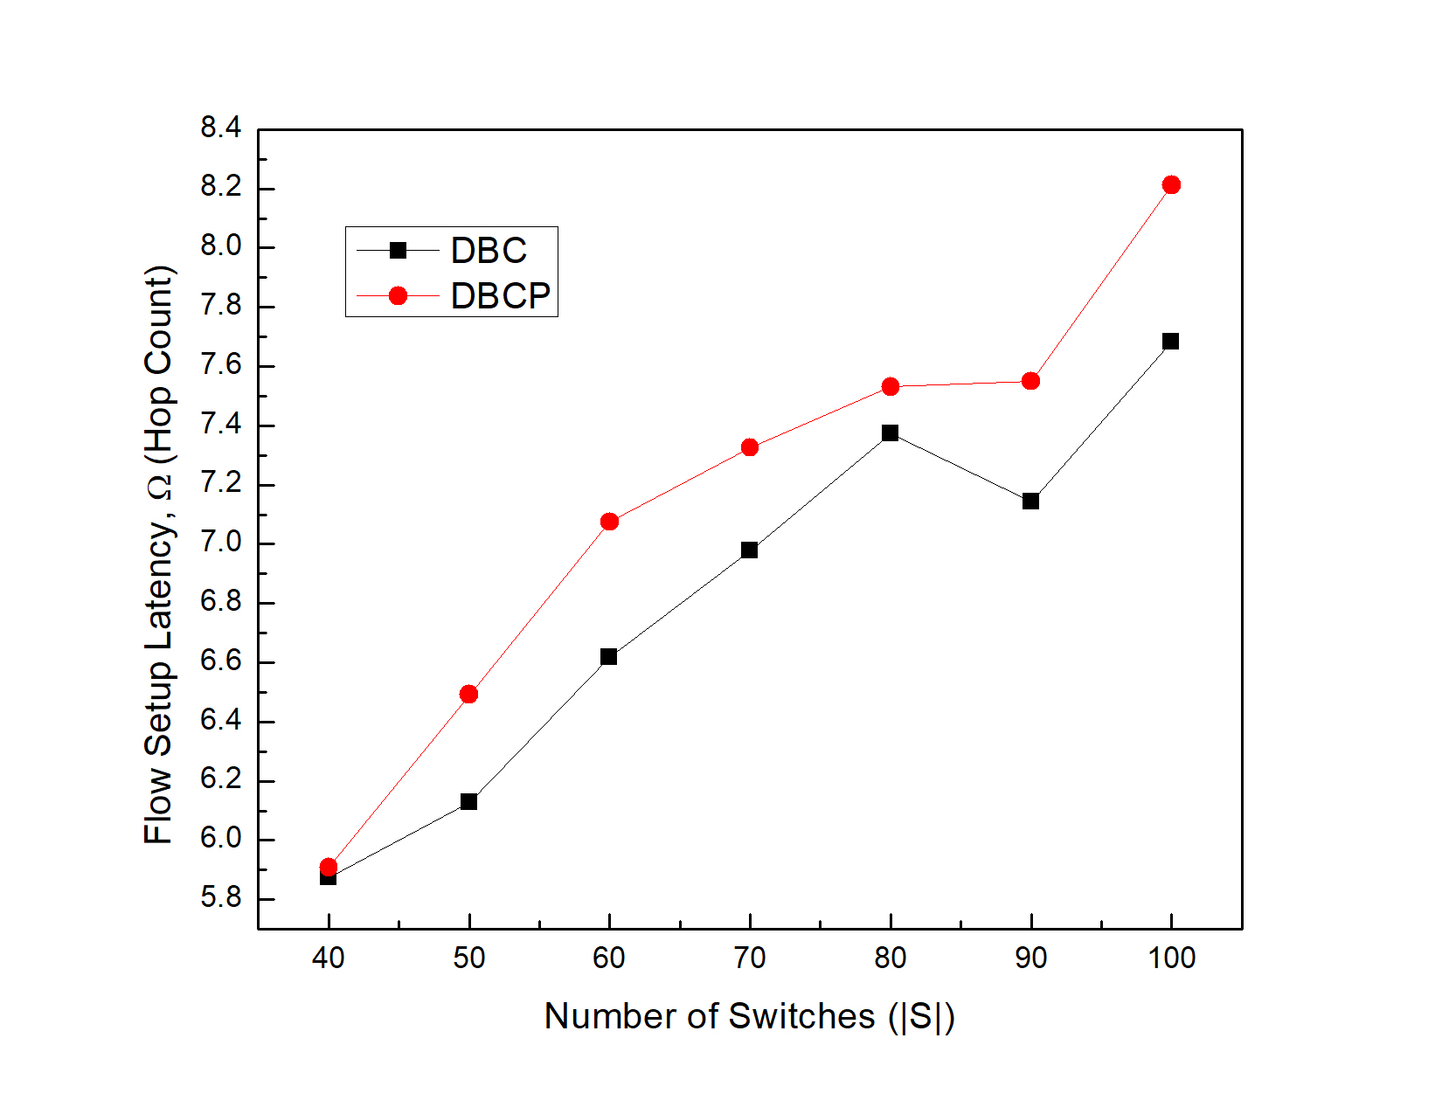
Experimental Analysis
Figure: Comparison
Between DBC and DBCP
in terms of Flow Setup
Latency for identical
numbers of controllers
Degree-based Balanced Clustering for Large-Scale Software Defined Networks

Slide 12
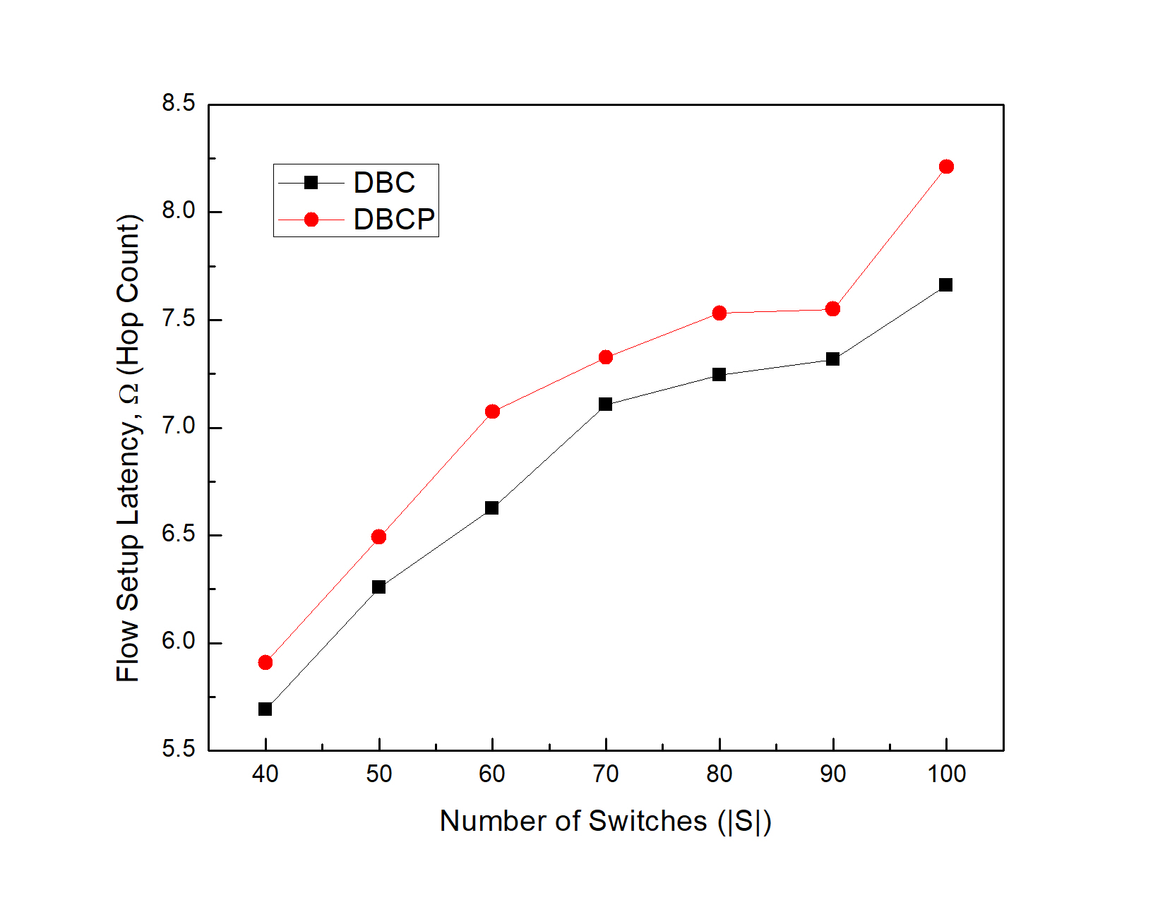
Experimental Analysis
Figure: Comparison
Between DBC and DBCP
in terms of Flow Setup
Latency for different
numbers of controllers
Degree-based Balanced Clustering for Large-Scale Software Defined Networks

Slide 13
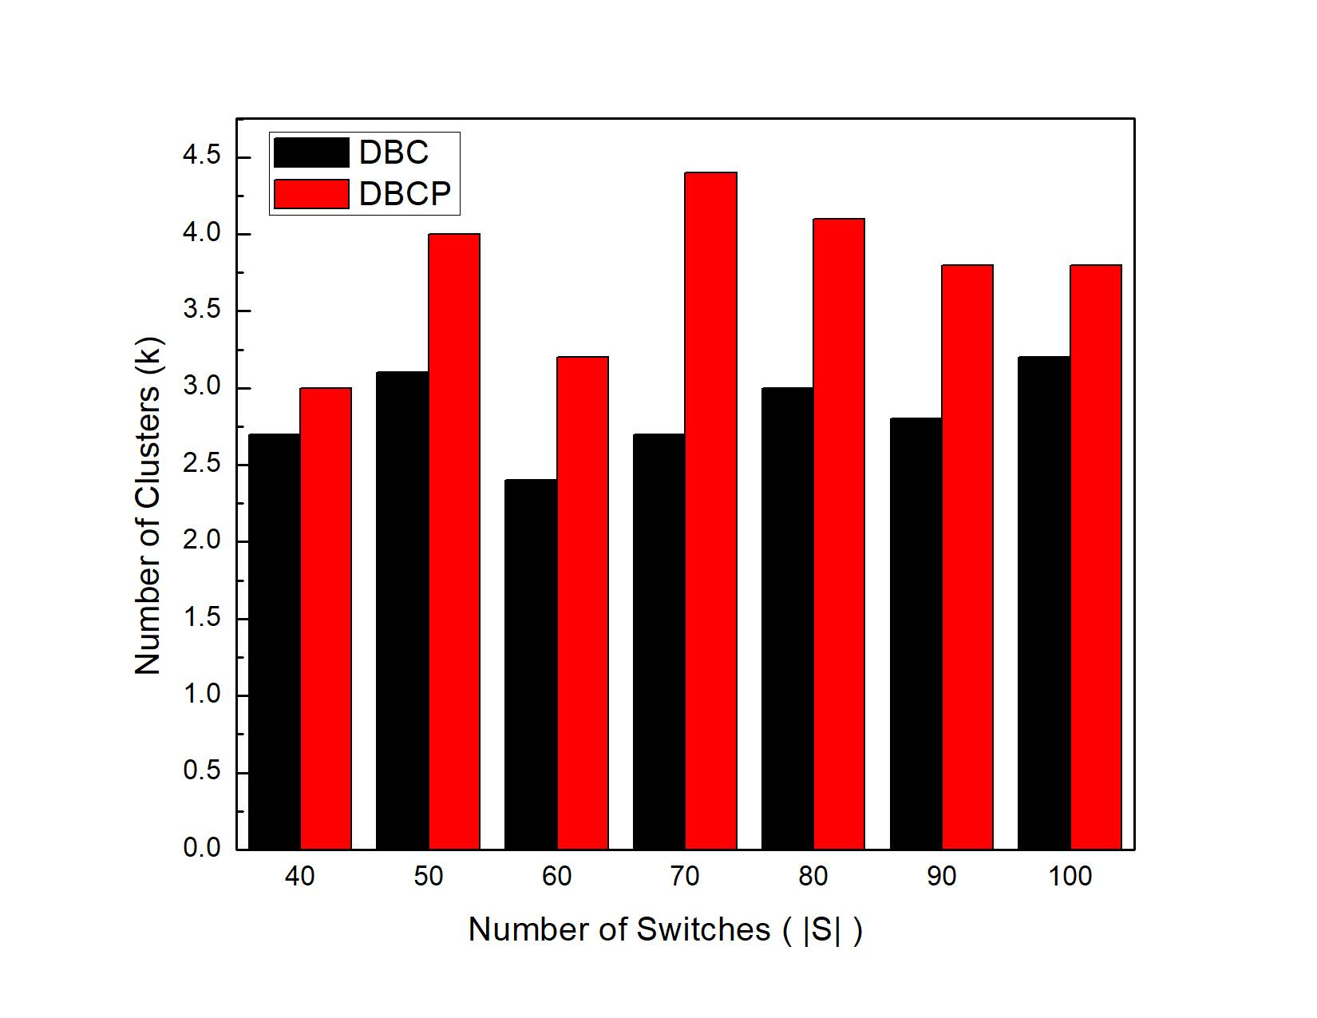
Experimental Analysis
Figure: Comparison
Between DBC and
DBCP in terms of
Number of controllers
Degree-based Balanced Clustering for Large-Scale Software Defined Networks

Slide 14
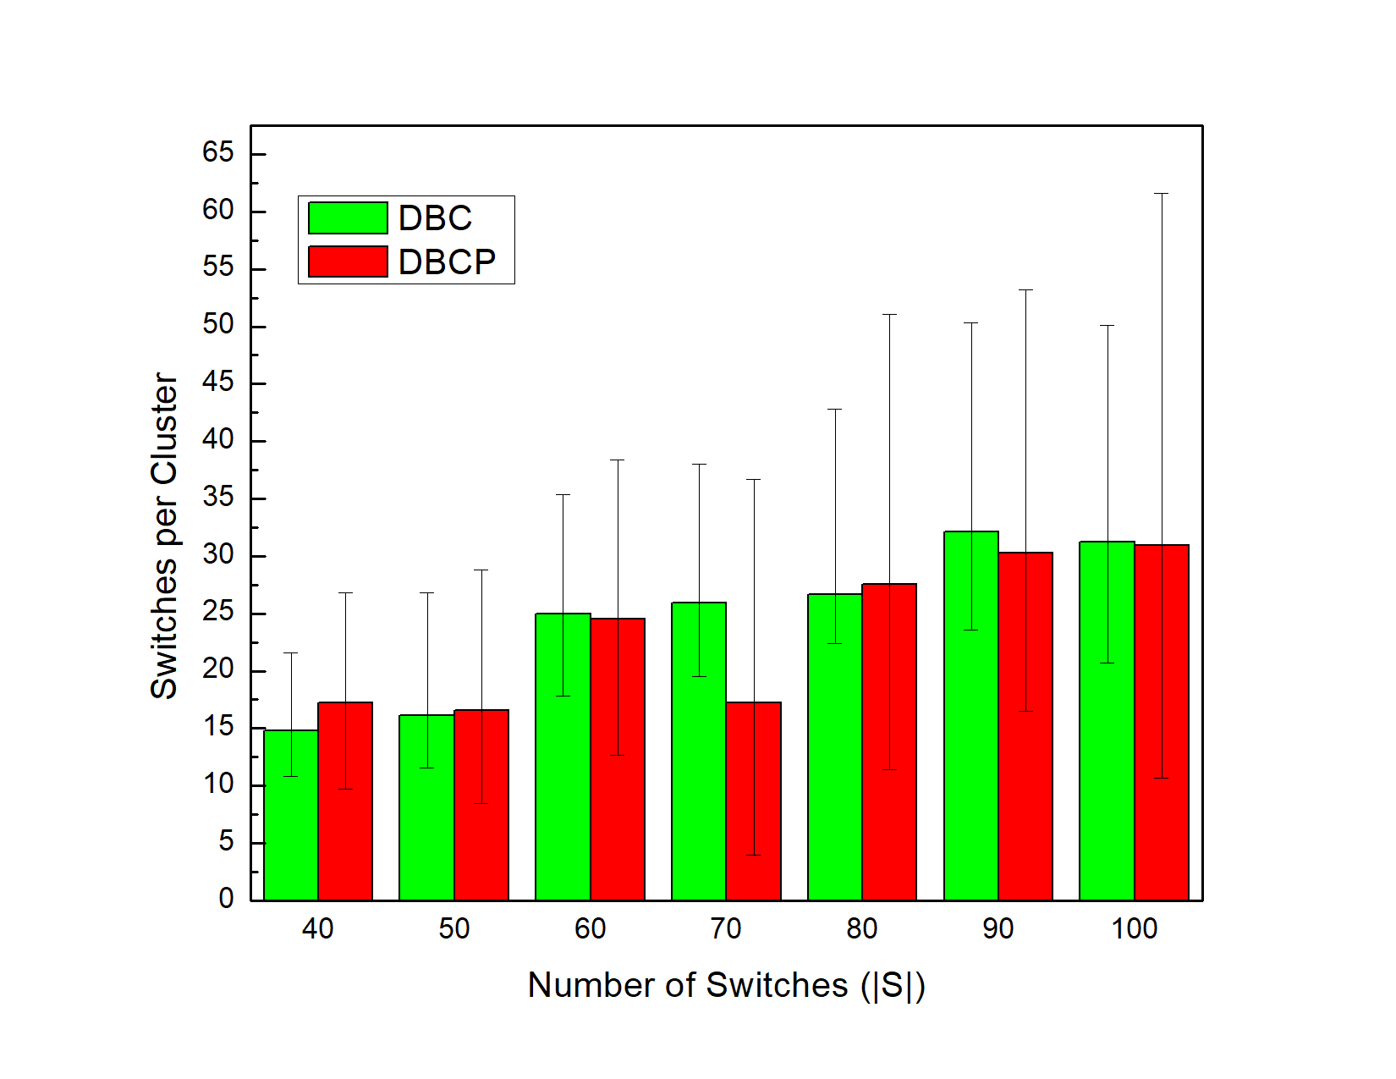
Experimental Analysis
Figure: Comparison
Between DBC and DBCP
in terms of maximum,
Minimum, and average
Switch distribution.
Degree-based Balanced Clustering for Large-Scale Software Defined Networks

Slide 15
Conclusion & Future Work
Conclusion
DBC outperforms DBCP in terms of flow-setup and route synchronization latencies.
DBC balances the load of the controllers.
Future Works:
If the improvement percentage is below a certain threshold, terminate the process.
Otherwise, continue in the same way and increment the number of controllers for another improvement calculation.
10
Degree-based Balanced Clustering for Large-Scale Software Defined Networks

Slide 16
References
[1] K. Greene, “Tr10: Software-defined networking.” Technology Review (MIT), 2009.
[2] A. Dixit, F. Hao, S. Mukherjee, T. Lakshman, and R. Kompella, “Towards an elastic distributed sdn controller”, in ACM SIGCOMM Computer Communication Review, vol. 43, no. 4. ACM, 2013, pp. 7-12.
[3] S. H. Yeganeh, A. Tootoonchian, and Y. Ganjali, “On scalability of software-defined networking,” IEEE Communications Magazine, vol. 51, no. 2, pp. 136–141, 2013.
[4] M. Al-Fares, S. Radhakrishnan, B. Raghavan, N. Huang, and A. Vahdat, “Hedera: Dynamic flow scheduling for data center networks.” in Nsdi, vol. 10, 2010, pp. 19–19
[5] S. Jain, A. Kumar, S. Mandal, J. Ong, L. Poutievski, A. Singh, S. Venkata, J. Wanderer, J. Zhou, M. Zhu et al., “B4: Experience with a globally-deployed software defined wan,” in ACM SIGCOMM Computer Communication Review, vol. 43, no. 4. ACM, 2013, pp. 3–14.
[6] M. Berman, J. S. Chase, L. Landweber, A. Nakao, M. Ott, D. Raychaudhuri, R. Ricci, and I. Seskar, “Geni: A federated testbed for innovative network experiments,” Computer Networks, vol. 61, pp. 5–23, 2014.
[7] I. T. Haque and N. Abu-Ghazaleh, “Wireless software defined networking: A survey and taxonomy,” IEEE Communications Surveys & Tutorials, vol. 18, no. 4, pp. 2713–2737, 2016.
34
Degree-based Balanced Clustering for Large-Scale Software Defined Networks

Slide 17
References
[8] R. Ahmed and R. Boutaba, “Design considerations for managing wide area software defined networks,” IEEE Communications Magazine, vol. 52, no. 7, pp. 116–123, 2014.
[9] S. Lange, S. Gebert, J. Spoerhase, P. Rygielski, T. Zinner, S. Kounev, and P. Tran-Gia, “Specialized heuristics for the controller placement problem in large scale sdn networks,” in Teletraffic Congress (ITC 27), 2015 27th International. Ghent, Belgium: IEEE, 2015, pp. 210–218.
[10] Y. Zhang, L. Cui, W. Wang, and Y. Zhang, “A survey on software defined networking with multiple controllers,” Journal of Network and Computer Applications, vol. 103, pp. 101–118, 2017.
[11] A. K. Singh and S. Srivastava, “A survey and classification of controller placement problem in sdn,” International Journal of Network Management, vol. 28, p. e2018, 2018.
[12] K. Sudheera, M. Ma, and P. Chong, “Controller placement optimization in hierarchical distributed software defined vehicular networks,” vol. 135, pp. 225–239, Apr 2018.
[13] J. H. Cox, J. Chung, S. Donovan, J. Ivey, R. J. Clark, G. Riley, and H. L. Owen, “Advancing software-defined networks: A survey,” IEEE Access, vol. 5, pp. 25 487–25 526, 2017.
[14] K. Sood, S. Yu, and Y. Xiang, “Software-defined wireless networking opportunities and challenges for internet-of-things: A review,” IEEE Internet of Things Journal, vol. 3, no. 4, pp. 453–463, 2016.
35
Degree-based Balanced Clustering for Large-Scale Software Defined Networks

Slide 18
References
[15] B. Heller, R. Sherwood, and N. McKeown, “The controller placement problem,” in Proceedings of the first workshop on Hot topics in software defined networks. NY, USA: ACM, Aug 2012, pp. 7–12.
[16] L. Yao, P. Hong, W. Zhang, J. Li, and D. Ni, “Controller placement and flow based dynamic management problem towards sdn,” in Communication Workshop (ICCW), 2015 IEEE International Conference on. London, UK: IEEE, Jun 2015, pp. 363–368.
[17] Y. Hu, W. Wendong, X. Gong, X. Que, and C. Shiduan, “Reliability-aware controller placement for software-defined networks,” in Integrated Network Management (IM 2013), 2013 IFIP/IEEE International Symposium on. Ghent, Belgium: IEEE, May 2013, pp. 672–675.
[18] Y. Zhang, N. Beheshti, and M. Tatipamula, “On resilience of split-architecture networks,” in Global Telecommunications Conference (GLOBECOM 2011), 2011 IEEE. Kathmandu, Nepal: IEEE, Dec 2011, pp. 1–6.
[19] S. Lange, S. Gebert, T. Zinner, P. Tran-Gia, D. Hock, M. Jarschel, and M. Hoffmann, “Heuristic approaches to the controller placement problem in large scale sdn networks,” IEEE Transactions on Network and Service Management, vol. 12, no. 1, pp. 4–17, 2015.
[20] A. Sallahi and M. St-Hilaire, “Optimal model for the controller placement problem in software defined networks,” IEEE communications letters, vol. 19, no. 1, pp. 30–33, 2015.
[21] J. Liao, H. Sun, J. Wang, Q. Qi, K. Li, and T. Li, “Density cluster based approach for controller placement problem in large-scale software defined networkings,” Computer Networks, vol. 112, pp. 24–35, 2017.
36
Degree-based Balanced Clustering for Large-Scale Software Defined Networks

Slide 19
THANKS!
Any questions?
You can find me at: salimur.choudhury@lakeheadu.ca

